Slide 1
Parts of Report
Department of Computer Science
Fouzia Goreja (Assistant Professor)

Slide 2
REPORT: Definition
A technical report is a formal report designed to convey technical information in a clear and easily accessible format.
Technical reports describe the process, progress, or results of technical or scientific research.
Include in-depth experimental details, data, and results.

Slide 3
INTRODUCTION
Reports have
formal format (often pre-designed layouts)
target audience
Report writing needs
analytical thinking, solid reasoning behind every conclusion,
careful reading, organized presentation.
facts and information specifically, no opinions.

Slide 4
Types of report
Formal Reports follow a FORMAT
Formal reports are meticulously structured
They focus on objectivity and organization
containing deeper detail
writer must write them in a style that eliminates subjectivity factors like personal pronouns. (I, we, you, they)

Slide 5
CONT..
2. Informal Reports :
Informal reports are usually short messages with free-flowing, casual use of language.
the internal report is considered informal
For example, a report among your peers, or for your small group or team, etc.

Slide 6
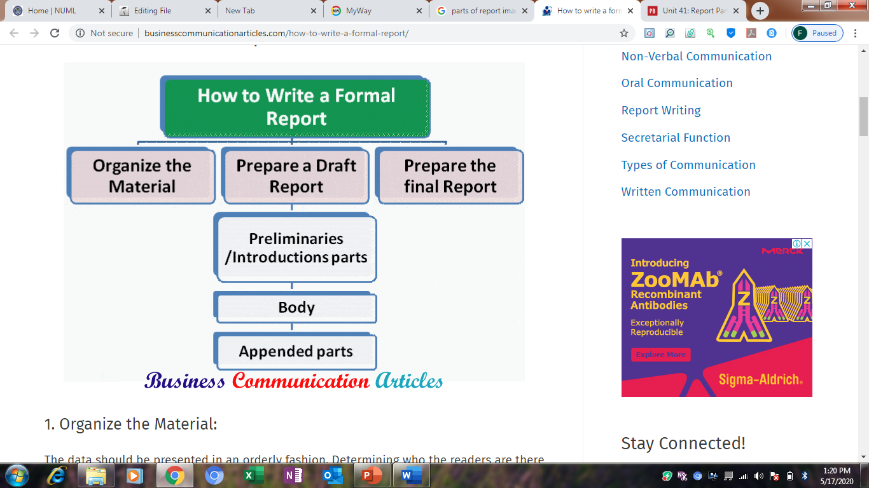

Slide 7
PARTS OF REPORT
THREE main parts:
FRONT MATTER: Title page, Abstract, TOC, List of tables/figures
MAIN TEXT: Introduction, Body, Conclusion
BACK MATTER: References, Glossary, Appendices.

Slide 8
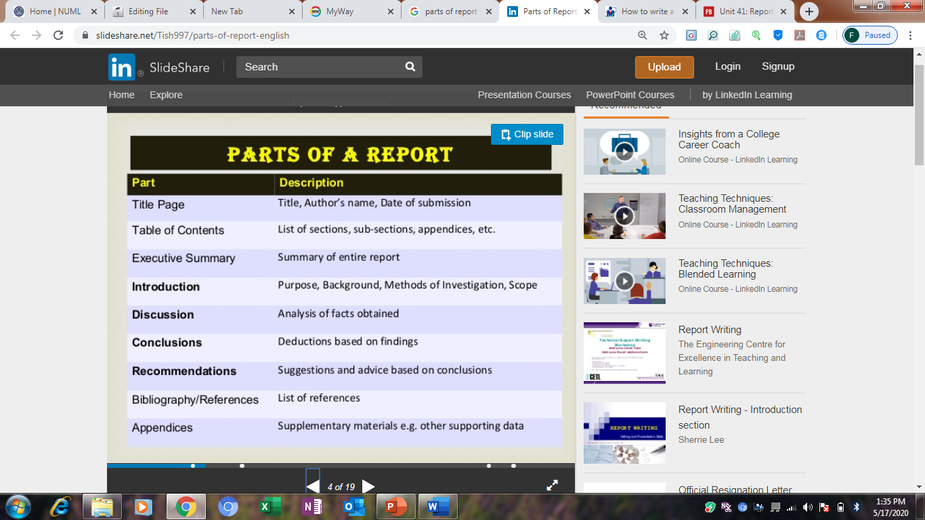

Slide 9
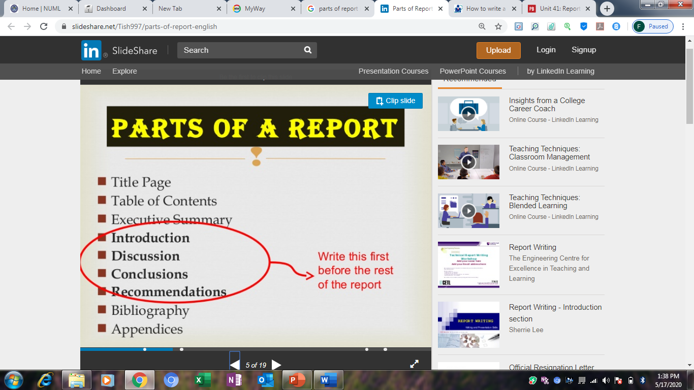

Slide 10
1. FRONT MATTER
Contains cover page
Title page: name of author/s, supervisor’s name, report’s title, organization name
Submission month and date
(PARTS)
Abstract
Table of Contents
List of illustrations

Slide 11
ABSTRACT
In a technical report structure, the abstract is:
End of report
like a technical summary of your project, usually ranging between 250-350 words of the report.
directed to readers who are familiar with the technical subject and need to know whether to read the full report or not.
using technical terminology(Key words) and refer to advanced concepts.

Slide 12
Table of contents
The structure of table of contents in the technical report enables readers to turn to specific pages to find the information they want.
Well organized report becomes ineffective if table of contents, is not clear.
T.O.C provides guidelines to report's structure, coverage and pagination.
The headings that appear in the report are enlisted in T.O.C. For effective T.O.C make sure the report has effective headings.

Slide 13
List of illustrations
It is a T.O.C for the figures and tables in the technical report.
If the report contains figures but not tables, it is called the list of figures.
But if the report contains tables but not figures so is called the list of tables only.
List of illustrations may be on the same page as the table of contents or may be on the separate page.
If it begins on a separate page, it should be listed in the table of contents.

Slide 14
2.Main text: Introduction
This part introduces the reader to your report, sets the purpose in place and broadly presents the content of your entire document.
This section gives the reader the necessary background information and leads straight into the report itself.

Slide 15
Main text: Discussion(Body)
This is usually the longest part in the structure of the report, so the material must be presented logically to make it easy to read.
It is divided into numbered and heading/subheading sections. These sections/ chapters separate the different main ideas in a logical order.

Slide 16
Cont..
This will include the main contents of the report like
what task was at hand,
what were the findings,
what methodology was used to figure out the findings,
comparison and discussion of the results.

Slide 17
Main text: Conclusion
A conclusive paragraph/chapter ties up all the information written before.
The conclusions should be a condensed version of the intervening sections giving the key findings of the work.
No NEW scientific argument should be presented here - everything should have already been discussed in the "Discussion".

Slide 18
3.BACK MATTER/ References/ Works cited/Compulsory
(IEEE format)
List of materials that you directly used in your report such as
algorithms, experimental results, figures, and/or tables that are not originally yours
E-Books/Authors
Research Papers/Authors
Websites/Articles/authors

Slide 19
Appendix A/B I/II/III
Data backing up your claims in the body.
Supporting information that would disrupt the main flow of the report. For conciseness in the report, this information is separated from the body.
Detailed calculations if necessary and contribute to the document

Slide 20
Appendices(optional)
Examples of the kind of material that are usually found in the appendix include maps, large technical diagrams or charts, computations, test data and texts of supporting documents.
Appendices are usually lettered, rather than numbered and are listed in the table of contents.

Slide 21
Glossary(optional)
A glossary is an alphabetic list of definitions.
It is useful if you are addressing a diverse audience that includes readers who will not be familiar with the technical vocabulary used in the report.
An asterisk * ^or any other notation can be used along with the word to tell the audience that the word is defined in glossary.
Discrete structures*

Slide 22
